Slide 1

CAP444 OBJECT ORIENTED PROGRAMMING USING C++

Slide 2
INHERITANCE
Inheritance is a feature or a process in which, new classes are created from the existing classes. The new class created is called “derived class” or “child class” and the existing class is known as the “base class” or “parent class”. The derived class now is said to be inherited from the base class.
The derived class inherits all the properties of the base class, without changing the properties of base class and may add new features to its own. These new features in the derived class will not affect the base class. The derived class is the specialized class for the base class.
Sub Class: The class that inherits properties from another class is called Subclass or Derived Class.
Super Class: The class whose properties are inherited by a subclass is called Base Class or Superclass.

Slide 3
Inheritance
One class can be derived from other class.
We can make the relationship between the classes.
We can re-use the functionality of classes
We can use different form of inheritance
Base Class
Derived Class

Slide 4



Inheritance: reusability
father
mother
child

Slide 5

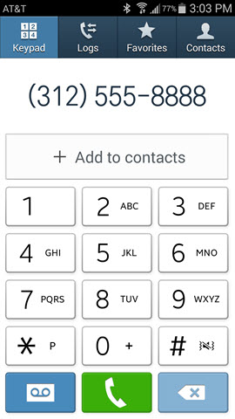

Contact List

Slide 6
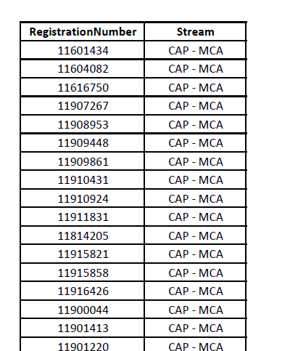
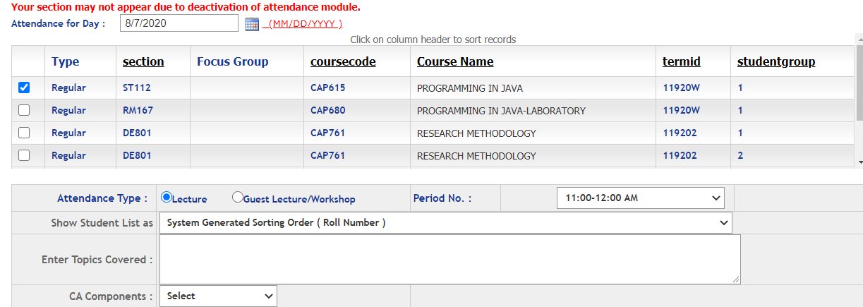
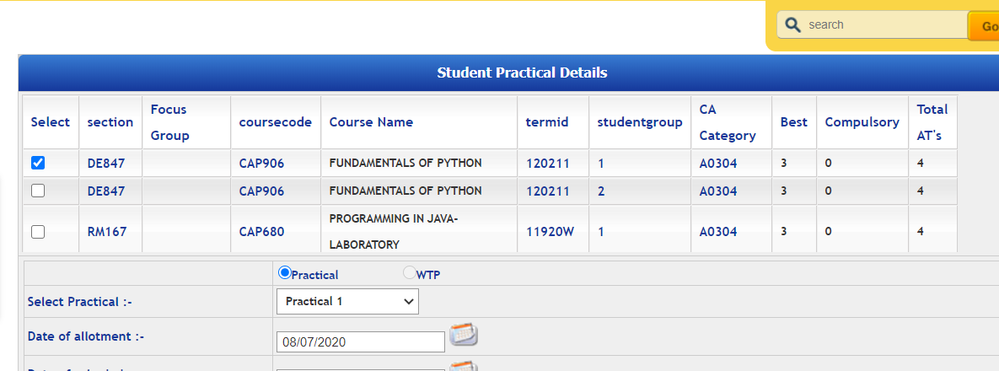
Students
Students in Attendance Module
Same Students in CA Module

Slide 7
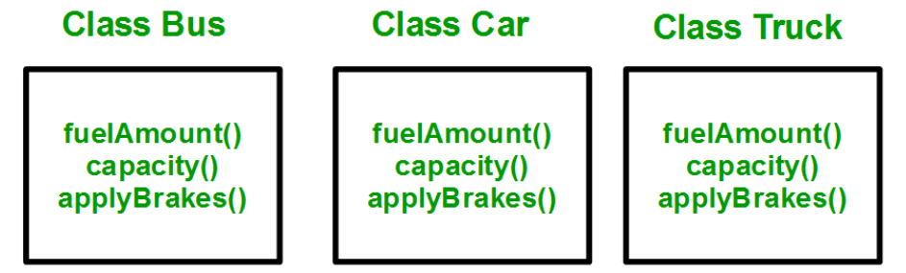
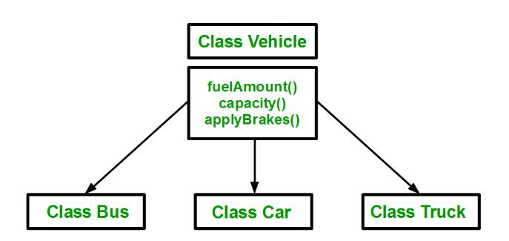

Slide 8
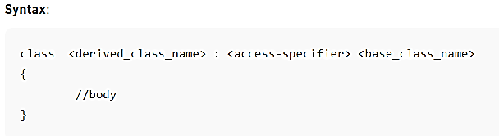
class — keyword to create a new class
derived_class_name — name of the new class, which will inherit the base class
access-specifier — either of private, public or protected. If neither is specified, PRIVATE is taken as default
base-class-name — name of the base class

Slide 9
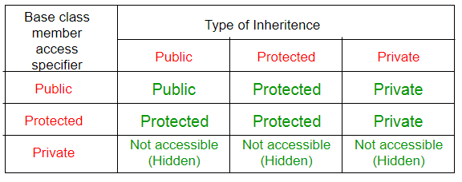
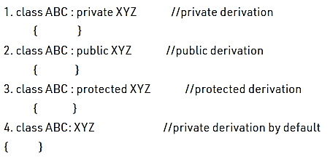
Modes of Inheritance: There are 3 modes of inheritance.
Public Mode: If we derive a subclass from a public base class. Then the public member of the base class will become public in the derived class and protected members of the base class will become protected in the derived class.
Protected Mode: If we derive a subclass from a Protected base class. Then both public members and protected members of the base class will become protected in the derived class.
Private Mode: If we derive a subclass from a Private base class. Then both public members and protected members of the base class will become Private in the derived class.

Slide 10
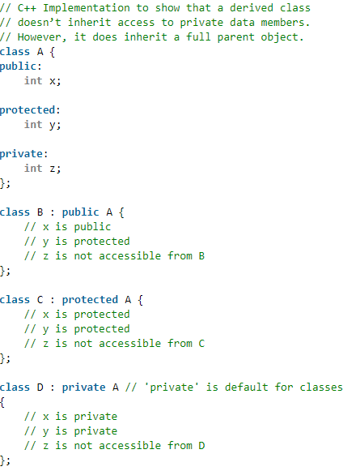

Slide 11
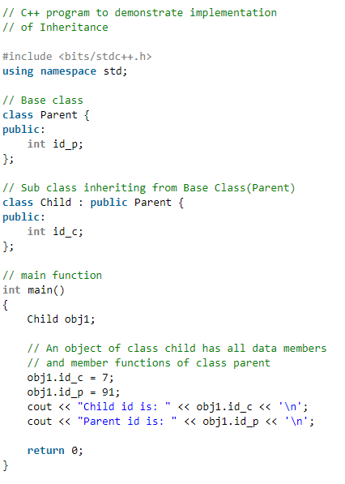

Slide 12
Inheritance: types of inheritance
A
A
A
B
B
B
C
C
Single
Multilevel
Multiple

Slide 13
A
A
B
C
B
C
Hierarchical Inheritance
D
Hybrid Inheritance

Slide 14
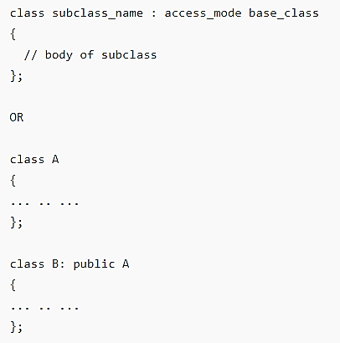
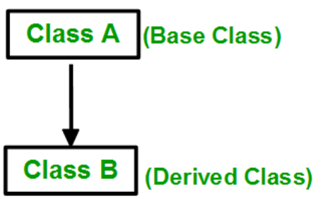
Single inheritance:
In single inheritance, a class is allowed to inherit from only one class. i.e. one subclass is inherited by one base class only.

Slide 15
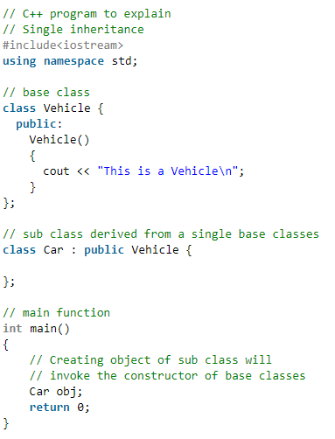


Slide 16
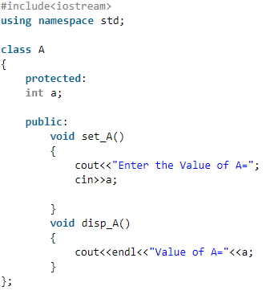
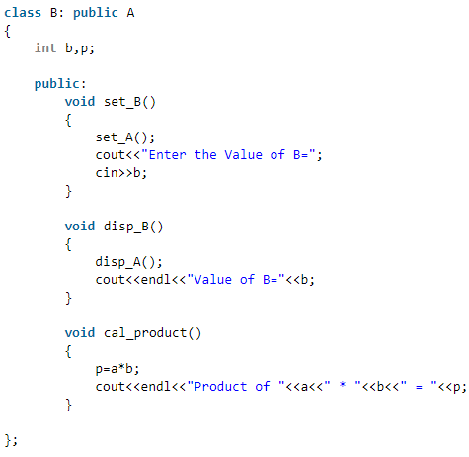
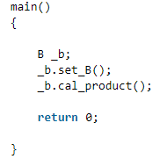

Slide 17
Multiple Inheritance
class Derived: public Base1, public Base2, ......
class Base1:
class Base2:
.
.
.
class BaseN:
A
B
C

Slide 18



Multiple inheritance
Multiple Inheritance is a feature of C++ where a class can inherit from more than one class. i.e one subclass is inherited from more than one base class.
student

Slide 19
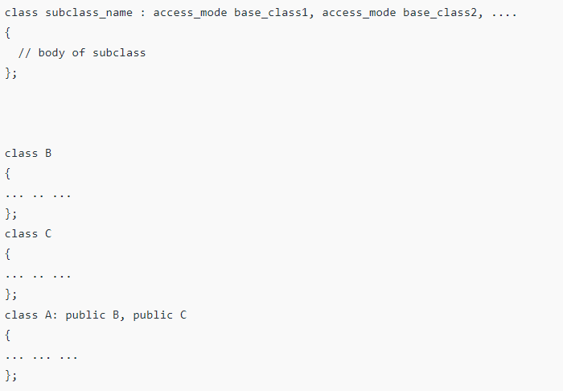
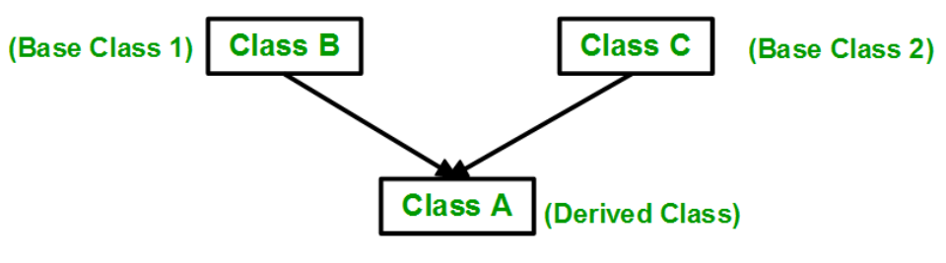
Multiple inheritance

Slide 20
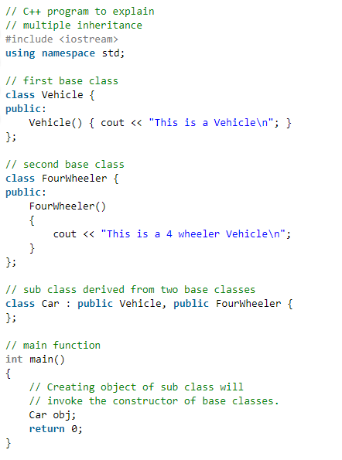
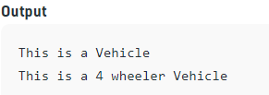

Slide 21
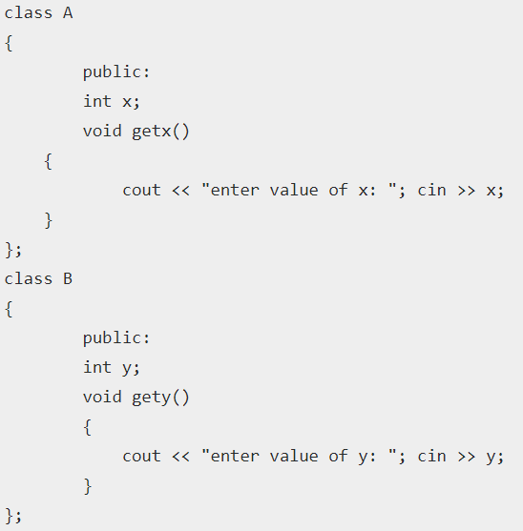
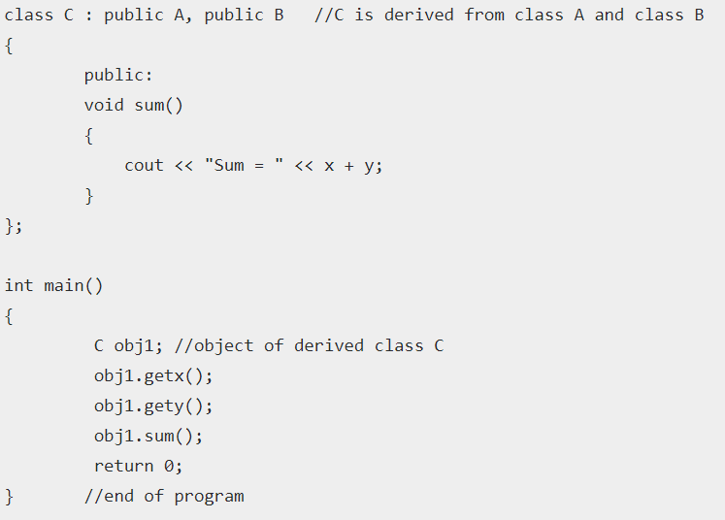


Slide 22
Multilevel inheritance:
One class is going to become base class for other derived class
PMFund
FundAmount=1000
Base Class for class Bank
Bank
BankName=“SBI” IFSCCode=“SBI001”
Derived Class from PMFund and
Base Class for Customer
Customer
Cust_Name, Cust_Id, BalanceAmount
checkBalance():
Derived Class from Bank

Slide 23





Hierarchical inheritance:
One base class and multiple derived class, one –to-many relationship

Slide 24
Multiple Inheritance
class Derived: public Base1, public Base2, ......
class Base1:
class Base2:
.
.
.
class BaseN:
A
B
C

Slide 25
student

Slide 26
Ambiguity in Inheritance
In multiple inheritances, when one class is derived from two or more base classes then there may be a possibility that the base classes have functions with the same name.
getUniversityDetails()
getUniversityDetails()
?

Slide 27

We can solve using scope resolution operator
Syntax:
ObjectName.ClassName::FunctionName();

Slide 28
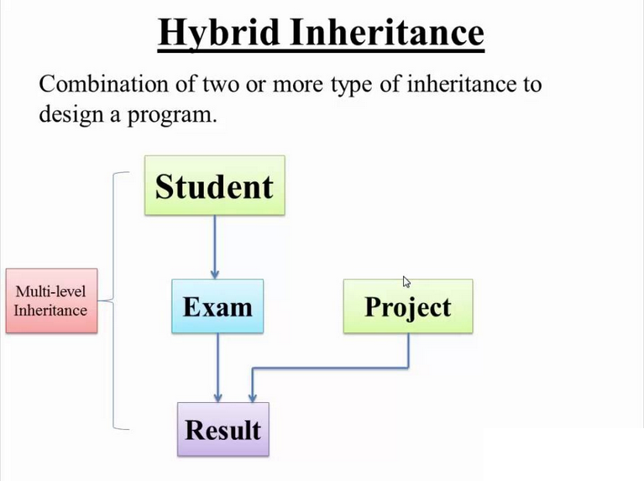

Slide 29
#include <iostream>
using namespace std;
class MyBaseClass {
public:
MyBaseClass(int x) {
cout << "Constructor of base class: " << x << endl;
}
};
class MyDerivedClass : public MyBaseClass {
public:
MyDerivedClass(int y) : MyBaseClass(50) {
cout << "Constructor of derived class: " << y << endl;
}
};
int main() {
MyDerivedClass derived(100);
}
Output:
Constructor of base class: 50
Constructor of derived class: 100
To call base class constructor in derived class

Slide 30


Type Conversion

Slide 31
Type Conversion
Basic data types conversion done automatic by compiler
User define data type conversion not done automatically
User define data type conversion done by using either constructor or by using casting operator

Slide 32
What will be output?
#include <iostream>
using namespace std;
int main()
{
double a = 21.09399;
float b = 10.20f;
int c ;
c = a;
cout << c ;
c = b;
cout << c ;
return 0;
}
2110
1210
21
121

Slide 33
Three type of situation occurs during user define type conversion:
1. basic type to class type(using constructor)
2. class type to basic type(using casting operator function)
3. class type to class type (using constructor and casting operator function both)

Slide 34
basic type to class type(using constructor)
#include <iostream>
using namespace std;
class A
{
};
int main()
{
A a1;
int x=8;
a1=x ;//basic to class type
return 0;
}
Basic type to class type achieved by using constructor.

Slide 35
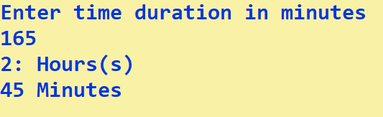
Time
hours, mins
display()

Slide 36
class type to basic type(using casting operator function)
Class type to basic type done by using casting operator function
It must be a define inside in class.
It must not specify a return type in function signature.
It must not have any arguments.
class A
{};
A a1;
int x;
x=a1 //class type to basic type

Slide 37
casting operator function
Syntax:
operator dest_typename()
{
return statement;
}
operator int()
{
return a;
}

Slide 38
class type to class type (using constructor and casting operator function both)
Ex: A obj1; B obj2;
obj1 = obj2 ; // obj1 and obj2 are objects of different classes
First approach using Constructor:-
Left side of assignment operator(=) which is class object we have to create constructor in that class here in Class A.
Second approach using casting operator function:
Right side of assignment operator(=) which is class object we have to create casting operator function in that class here class B.

Slide 39
Any Query?

